Slide 1
Welcome To Bible Drill!!!
Schedule
Bible Periods and Song
Books of the NT- Song
NT Words
Boys Leading

Slide 2
Fruit of the Spirit Song

Slide 3
Read Your Bible and Pray Every Day and Grow, Grow, Grow

Slide 4
If you’re happy and you know it

Slide 6
OH HOW I LOVE JESUS
Verse 1
Guys: Oh girls do you love Jesus?
Girls: Oh, yes we love Jesus!
Guys: Are you sure you love Jesus?
Girls: Yes, we’re sure we love Jesus!
Guys: Tell us why you love Jesus.
Girls: This is why we love Jesus,
Together: Because he first loved me
Verse 2
Girls: Oh boys do you love Jesus?
Guys: Oh, yes we love Jesus!
Girls: Are you sure you love Jesus?
Guys: Yes, we’re sure we love Jesus!
Girls: Tell us why you love Jesus.
Guys: This is why we love Jesus
Together: Because he first loved me
*CHORUS:
Oh, how I love Jesus! Oh, how I love Jesus!
Oh, how I love Jesus, because he first loved me!

Slide 7
New Testament Books
Matthew…King

Slide 8
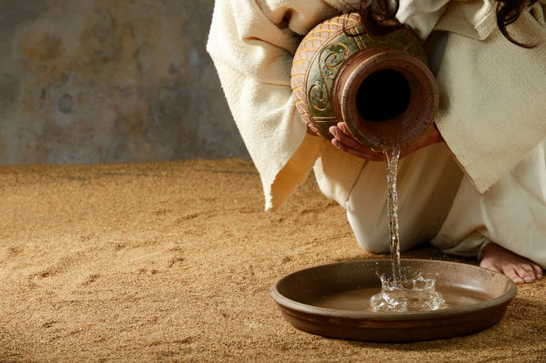
New Testament Books
Matthew…King
Mark…Servant

Slide 9
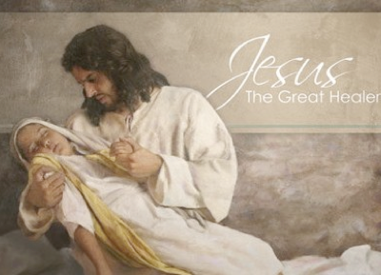
New Testament Books
Matthew…King
Mark…Servant
Luke…Healer

Slide 10
New Testament Books
Matthew…King
Mark…Servant
Luke…Healer
John…Light

Slide 11
New Testament Books
Matthew…King
Mark…Servant
Luke…Healer
John…Light
Acts…Church

Slide 12
New Testament Books
Matthew…King
Mark…Servant
Luke…Healer
John…Light
Acts…Church
Romans…Gospel

Slide 13
New Testament Books
Matthew…King
Mark…Servant
Luke…Healer
John…Light
Acts…Church
Romans…Gospel
1 Corinthians…Problem

Slide 14
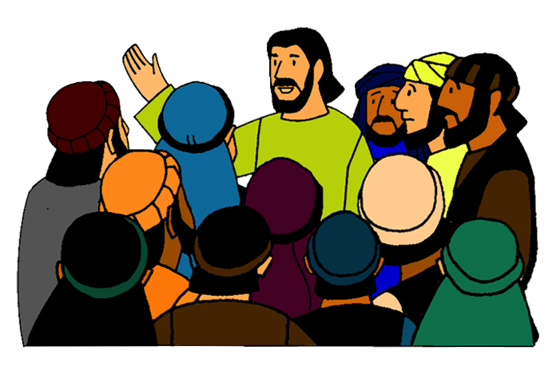
New Testament Books
Matthew…King
Mark…Servant
Luke…Healer
John…Light
Acts…Church
Romans…Gospel
1 Corinthians…Problem
2 Corinthians…Apostle

Slide 15
New Testament Books
Matthew…King
Mark…Servant
Luke…Healer
John…Light
Acts…Church
Romans…Gospel
1 Corinthians…Problem
2 Corinthians…Apostle
Galatians- Freedom

Slide 16
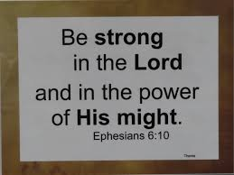
New Testament Books
Matthew…King
Mark…Servant
Luke…Healer
John…Light
Acts…Church
Romans…Gospel
1 Corinthians…Problem
2 Corinthians…Apostle
Galatians- Freedom
Ephesians- Strong

Slide 17
New Testament Books
Matthew…King
Mark…Servant
Luke…Healer
John…Light
Acts…Church
Romans…Gospel
1 Corinthians…Problem
2 Corinthians…Apostle
Galatians- Freedom
Ephesians- Strong
Philippians- Joy

Slide 18
New Testament Books
Matthew…King
Mark…Servant
Luke…Healer
John…Light
Acts…Church
Romans…Gospel
1 Corinthians…Problem
2 Corinthians…Apostle
Galatians- Freedom
Ephesians- Strong
Philippians- Joy
Colossians- Complete

Slide 19
New Testament Books
Matthew…King
Mark…Servant
Luke…Healer
John…Light
Acts…Church
Romans…Gospel
1 Corinthians…Problem
2 Corinthians…Apostle
Galatians- Freedom
Ephesians- Strong
Philippians- Joy
Colossians- Complete
1 Thessalonians- Coming

Slide 20
New Testament Books
Matthew…King
Mark…Servant
Luke…Healer
John…Light
Acts…Church
Romans…Gospel
1 Corinthians…Problem
2 Corinthians…Apostle
Galatians- Freedom
Ephesians- Strong
Philippians- Joy
Colossians- Complete
1 Thessalonians- Coming
2 Thessalonians- False

Slide 21
New Testament Books
Galatians- Freedom
Ephesians- Strong
Philippians- Joy
Colossians- Complete
1 Thessalonians- Coming
2 Thessalonians- False
1 Timothy- Preach
Matthew…King
Mark…Servant
Luke…Healer
John…Light
Acts…Church
Romans…Gospel
1 Corinthians…Problem
2 Corinthians…Apostle

Slide 22
New Testament Books
Matthew…King
Mark…Servant
Luke…Healer
John…Light
Acts…Church
Romans…Gospel
1 Corinthians…Problem
2 Corinthians…Apostle
Galatians- Freedom
Ephesians- Strong
Philippians- Joy
Colossians- Complete
1 Thessalonians- Coming
2 Thessalonians- False
1 Timothy- Preach
2 Timothy- Farewell

Slide 23
Songs

Slide 24
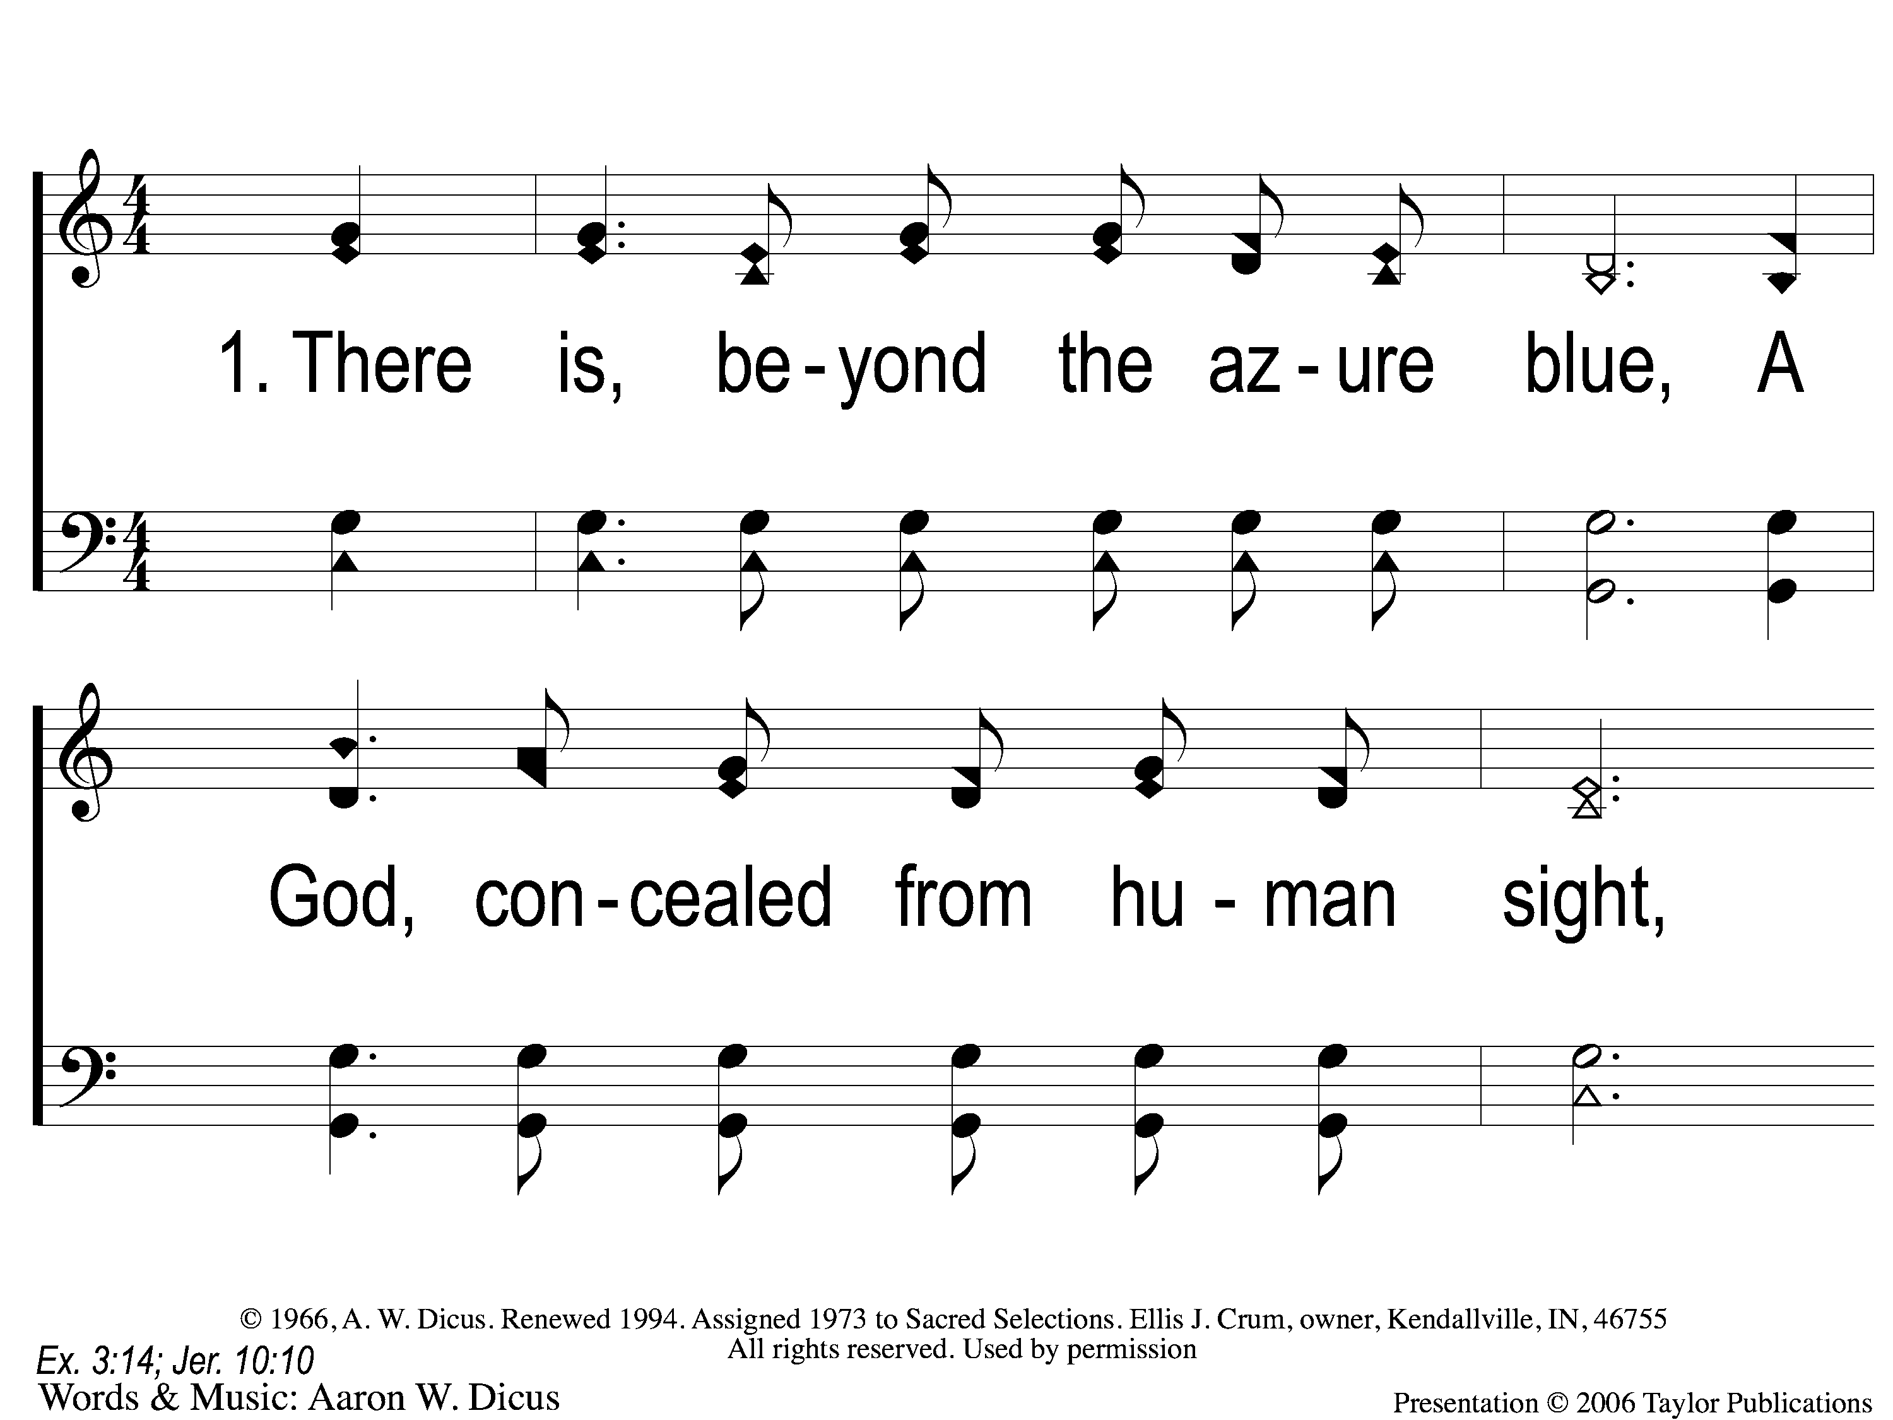
1-1 Our God He Is Alive
Our God He is Alive
22
Notes:
Slide # Slide Title
--------> 1 1-1 Our God He Is Alive
2 1-2 Our God He Is Alive
3 C-1 Our God He Is Alive
4 C-2 Our God He Is Alive
5 2-1 Our God He Is Alive
6 2-2 Our God He Is Alive
7 C-1 Our God He Is Alive
8 C-2 Our God He Is Alive
9 3-1 Our God He Is Alive
10 3-2 Our God He Is Alive
11 C-1 Our God He Is Alive
12 C-2 Our God He Is Alive
13 4-1 Our God He Is Alive
14 4-2 Our God He Is Alive
15 C-1 Our God He Is Alive
16 C-2 Our God He Is Alive
(Type slide number and press <Enter> to jump slides)

Slide 25
1-2 Our God He Is Alive
Our God He is Alive
22
Notes:
Slide # Slide Title
1 1-1 Our God He Is Alive
--------> 2 1-2 Our God He Is Alive
3 C-1 Our God He Is Alive
4 C-2 Our God He Is Alive
5 2-1 Our God He Is Alive
6 2-2 Our God He Is Alive
7 C-1 Our God He Is Alive
8 C-2 Our God He Is Alive
9 3-1 Our God He Is Alive
10 3-2 Our God He Is Alive
11 C-1 Our God He Is Alive
12 C-2 Our God He Is Alive
13 4-1 Our God He Is Alive
14 4-2 Our God He Is Alive
15 C-1 Our God He Is Alive
16 C-2 Our God He Is Alive
(Type slide number and press <Enter> to jump slides)

Slide 26
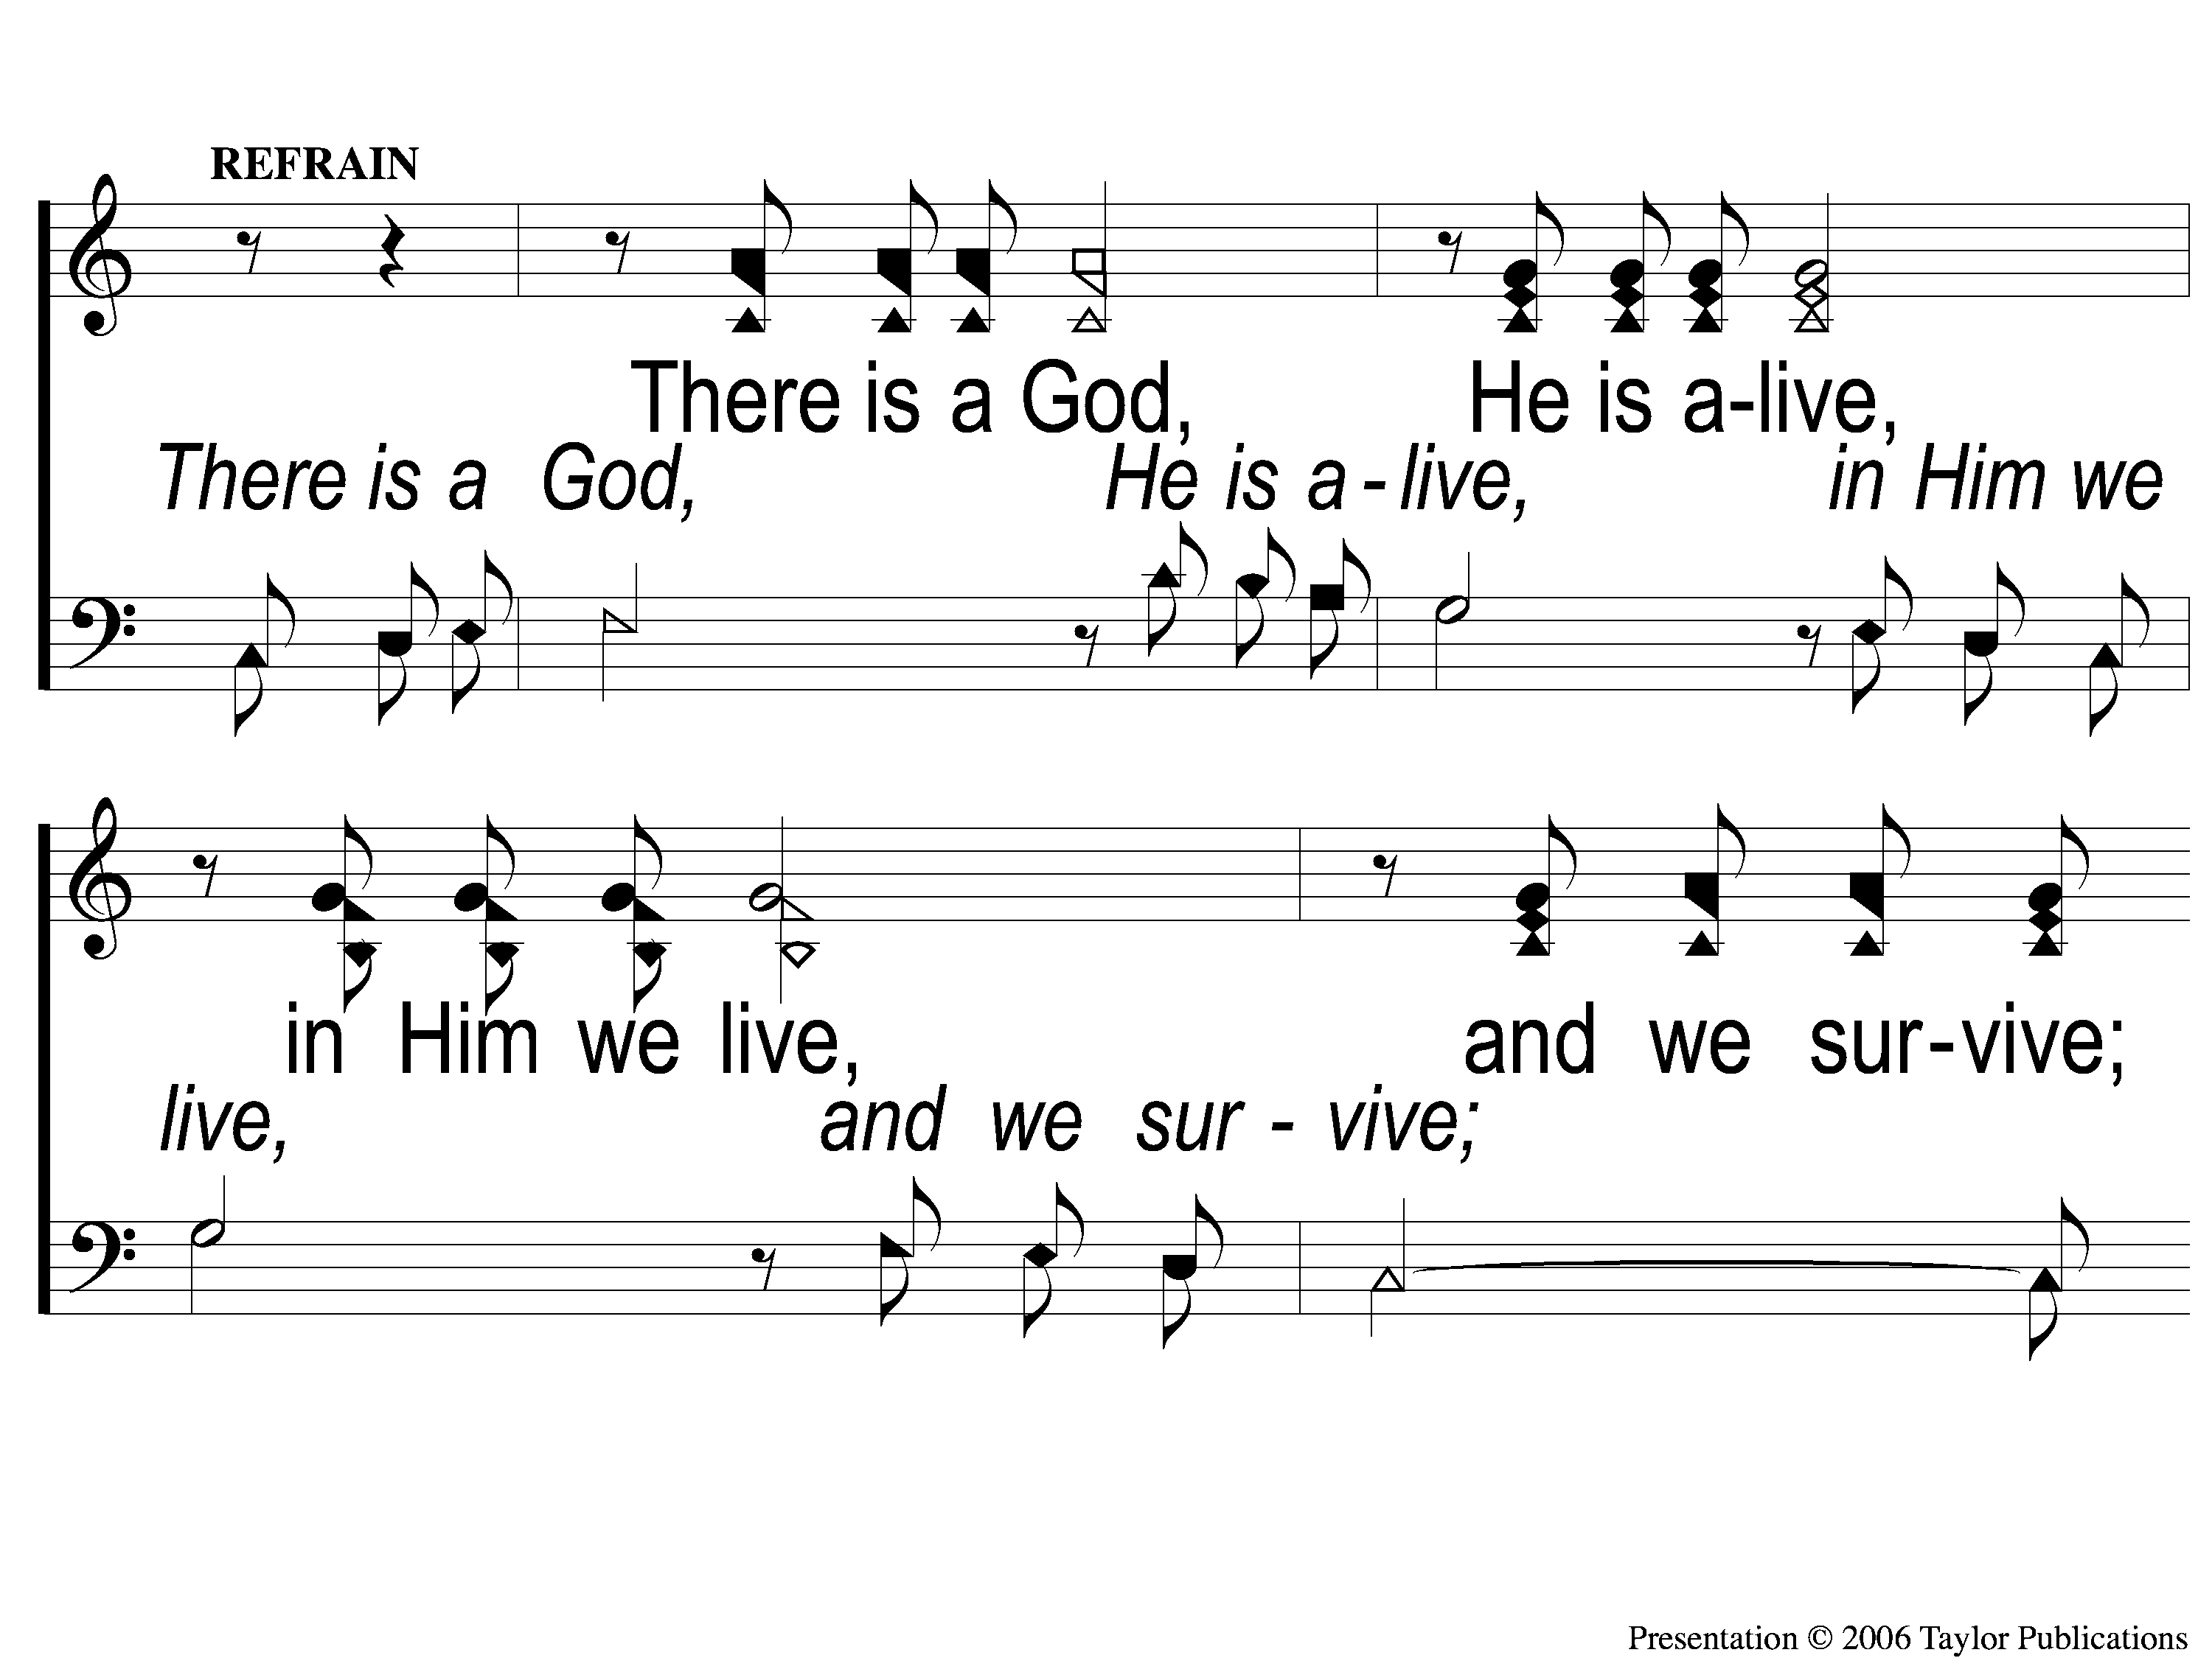
C-1 Our God He Is Alive
Our God He is Alive
22
Notes:
Slide # Slide Title
1 1-1 Our God He Is Alive
2 1-2 Our God He Is Alive
--------> 3 C-1 Our God He Is Alive
4 C-2 Our God He Is Alive
5 2-1 Our God He Is Alive
6 2-2 Our God He Is Alive
7 C-1 Our God He Is Alive
8 C-2 Our God He Is Alive
9 3-1 Our God He Is Alive
10 3-2 Our God He Is Alive
11 C-1 Our God He Is Alive
12 C-2 Our God He Is Alive
13 4-1 Our God He Is Alive
14 4-2 Our God He Is Alive
15 C-1 Our God He Is Alive
16 C-2 Our God He Is Alive
(Type slide number and press <Enter> to jump slides)

Slide 27
C-2 Our God He Is Alive
Our God He is Alive
22
Notes:
Slide # Slide Title
1 1-1 Our God He Is Alive
2 1-2 Our God He Is Alive
3 C-1 Our God He Is Alive
--------> 4 C-2 Our God He Is Alive
5 2-1 Our God He Is Alive
6 2-2 Our God He Is Alive
7 C-1 Our God He Is Alive
8 C-2 Our God He Is Alive
9 3-1 Our God He Is Alive
10 3-2 Our God He Is Alive
11 C-1 Our God He Is Alive
12 C-2 Our God He Is Alive
13 4-1 Our God He Is Alive
14 4-2 Our God He Is Alive
15 C-1 Our God He Is Alive
16 C-2 Our God He Is Alive
(Type slide number and press <Enter> to jump slides)

Slide 28
2-1 Our God He Is Alive
Our God He is Alive
22
Notes:
Slide # Slide Title
1 1-1 Our God He Is Alive
2 1-2 Our God He Is Alive
3 C-1 Our God He Is Alive
4 C-2 Our God He Is Alive
--------> 5 2-1 Our God He Is Alive
6 2-2 Our God He Is Alive
7 C-1 Our God He Is Alive
8 C-2 Our God He Is Alive
9 3-1 Our God He Is Alive
10 3-2 Our God He Is Alive
11 C-1 Our God He Is Alive
12 C-2 Our God He Is Alive
13 4-1 Our God He Is Alive
14 4-2 Our God He Is Alive
15 C-1 Our God He Is Alive
16 C-2 Our God He Is Alive
(Type slide number and press <Enter> to jump slides)

Slide 29
2-2 Our God He Is Alive
Our God He is Alive
22
Notes:
Slide # Slide Title
1 1-1 Our God He Is Alive
2 1-2 Our God He Is Alive
3 C-1 Our God He Is Alive
4 C-2 Our God He Is Alive
5 2-1 Our God He Is Alive
--------> 6 2-2 Our God He Is Alive
7 C-1 Our God He Is Alive
8 C-2 Our God He Is Alive
9 3-1 Our God He Is Alive
10 3-2 Our God He Is Alive
11 C-1 Our God He Is Alive
12 C-2 Our God He Is Alive
13 4-1 Our God He Is Alive
14 4-2 Our God He Is Alive
15 C-1 Our God He Is Alive
16 C-2 Our God He Is Alive
(Type slide number and press <Enter> to jump slides)

Slide 30
C-1 Our God He Is Alive
Our God He is Alive
22
Notes:
Slide # Slide Title
1 1-1 Our God He Is Alive
2 1-2 Our God He Is Alive
3 C-1 Our God He Is Alive
4 C-2 Our God He Is Alive
5 2-1 Our God He Is Alive
6 2-2 Our God He Is Alive
--------> 7 C-1 Our God He Is Alive
8 C-2 Our God He Is Alive
9 3-1 Our God He Is Alive
10 3-2 Our God He Is Alive
11 C-1 Our God He Is Alive
12 C-2 Our God He Is Alive
13 4-1 Our God He Is Alive
14 4-2 Our God He Is Alive
15 C-1 Our God He Is Alive
16 C-2 Our God He Is Alive
(Type slide number and press <Enter> to jump slides)

Slide 31
C-2 Our God He Is Alive
Our God He is Alive
22
Notes:
Slide # Slide Title
1 1-1 Our God He Is Alive
2 1-2 Our God He Is Alive
3 C-1 Our God He Is Alive
4 C-2 Our God He Is Alive
5 2-1 Our God He Is Alive
6 2-2 Our God He Is Alive
7 C-1 Our God He Is Alive
--------> 8 C-2 Our God He Is Alive
9 3-1 Our God He Is Alive
10 3-2 Our God He Is Alive
11 C-1 Our God He Is Alive
12 C-2 Our God He Is Alive
13 4-1 Our God He Is Alive
14 4-2 Our God He Is Alive
15 C-1 Our God He Is Alive
16 C-2 Our God He Is Alive
(Type slide number and press <Enter> to jump slides)

Slide 32
3-1 Our God He Is Alive
Our God He is Alive
22
Notes:
Slide # Slide Title
1 1-1 Our God He Is Alive
2 1-2 Our God He Is Alive
3 C-1 Our God He Is Alive
4 C-2 Our God He Is Alive
5 2-1 Our God He Is Alive
6 2-2 Our God He Is Alive
7 C-1 Our God He Is Alive
8 C-2 Our God He Is Alive
--------> 9 3-1 Our God He Is Alive
10 3-2 Our God He Is Alive
11 C-1 Our God He Is Alive
12 C-2 Our God He Is Alive
13 4-1 Our God He Is Alive
14 4-2 Our God He Is Alive
15 C-1 Our God He Is Alive
16 C-2 Our God He Is Alive
(Type slide number and press <Enter> to jump slides)

Slide 33
3-2 Our God He Is Alive
Our God He is Alive
22
Notes:
Slide # Slide Title
1 1-1 Our God He Is Alive
2 1-2 Our God He Is Alive
3 C-1 Our God He Is Alive
4 C-2 Our God He Is Alive
5 2-1 Our God He Is Alive
6 2-2 Our God He Is Alive
7 C-1 Our God He Is Alive
8 C-2 Our God He Is Alive
9 3-1 Our God He Is Alive
--------> 10 3-2 Our God He Is Alive
11 C-1 Our God He Is Alive
12 C-2 Our God He Is Alive
13 4-1 Our God He Is Alive
14 4-2 Our God He Is Alive
15 C-1 Our God He Is Alive
16 C-2 Our God He Is Alive
(Type slide number and press <Enter> to jump slides)

Slide 34
C-1 Our God He Is Alive
Our God He is Alive
22
Notes:
Slide # Slide Title
1 1-1 Our God He Is Alive
2 1-2 Our God He Is Alive
3 C-1 Our God He Is Alive
4 C-2 Our God He Is Alive
5 2-1 Our God He Is Alive
6 2-2 Our God He Is Alive
7 C-1 Our God He Is Alive
8 C-2 Our God He Is Alive
9 3-1 Our God He Is Alive
10 3-2 Our God He Is Alive
--------> 11 C-1 Our God He Is Alive
12 C-2 Our God He Is Alive
13 4-1 Our God He Is Alive
14 4-2 Our God He Is Alive
15 C-1 Our God He Is Alive
16 C-2 Our God He Is Alive
(Type slide number and press <Enter> to jump slides)

Slide 35
C-2 Our God He Is Alive
Our God He is Alive
22
Notes:
Slide # Slide Title
1 1-1 Our God He Is Alive
2 1-2 Our God He Is Alive
3 C-1 Our God He Is Alive
4 C-2 Our God He Is Alive
5 2-1 Our God He Is Alive
6 2-2 Our God He Is Alive
7 C-1 Our God He Is Alive
8 C-2 Our God He Is Alive
9 3-1 Our God He Is Alive
10 3-2 Our God He Is Alive
11 C-1 Our God He Is Alive
--------> 12 C-2 Our God He Is Alive
13 4-1 Our God He Is Alive
14 4-2 Our God He Is Alive
15 C-1 Our God He Is Alive
16 C-2 Our God He Is Alive
(Type slide number and press <Enter> to jump slides)

Slide 36
4-1 Our God He Is Alive
Our God He is Alive
22
Notes:
Slide # Slide Title
1 1-1 Our God He Is Alive
2 1-2 Our God He Is Alive
3 C-1 Our God He Is Alive
4 C-2 Our God He Is Alive
5 2-1 Our God He Is Alive
6 2-2 Our God He Is Alive
7 C-1 Our God He Is Alive
8 C-2 Our God He Is Alive
9 3-1 Our God He Is Alive
10 3-2 Our God He Is Alive
11 C-1 Our God He Is Alive
12 C-2 Our God He Is Alive
--------> 13 4-1 Our God He Is Alive
14 4-2 Our God He Is Alive
15 C-1 Our God He Is Alive
16 C-2 Our God He Is Alive
(Type slide number and press <Enter> to jump slides)

Slide 37
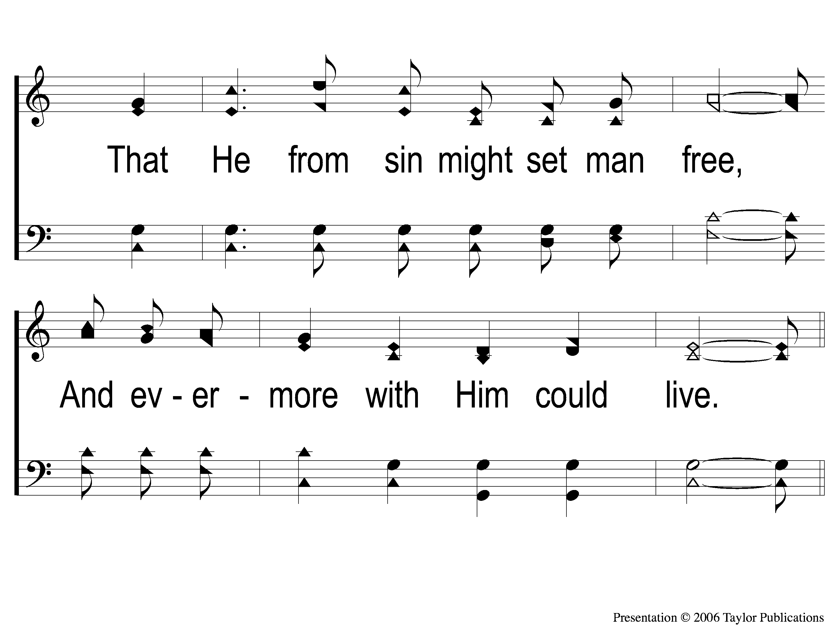
4-2 Our God He Is Alive
Our God He is Alive
22
Notes:
Slide # Slide Title
1 1-1 Our God He Is Alive
2 1-2 Our God He Is Alive
3 C-1 Our God He Is Alive
4 C-2 Our God He Is Alive
5 2-1 Our God He Is Alive
6 2-2 Our God He Is Alive
7 C-1 Our God He Is Alive
8 C-2 Our God He Is Alive
9 3-1 Our God He Is Alive
10 3-2 Our God He Is Alive
11 C-1 Our God He Is Alive
12 C-2 Our God He Is Alive
13 4-1 Our God He Is Alive
--------> 14 4-2 Our God He Is Alive
15 C-1 Our God He Is Alive
16 C-2 Our God He Is Alive
(Type slide number and press <Enter> to jump slides)

Slide 38
C-1 Our God He Is Alive
Our God He is Alive
22
Notes:
Slide # Slide Title
1 1-1 Our God He Is Alive
2 1-2 Our God He Is Alive
3 C-1 Our God He Is Alive
4 C-2 Our God He Is Alive
5 2-1 Our God He Is Alive
6 2-2 Our God He Is Alive
7 C-1 Our God He Is Alive
8 C-2 Our God He Is Alive
9 3-1 Our God He Is Alive
10 3-2 Our God He Is Alive
11 C-1 Our God He Is Alive
12 C-2 Our God He Is Alive
13 4-1 Our God He Is Alive
14 4-2 Our God He Is Alive
--------> 15 C-1 Our God He Is Alive
16 C-2 Our God He Is Alive
(Type slide number and press <Enter> to jump slides)

Slide 39
C-2 Our God He Is Alive
Our God He is Alive
22
Notes:
Slide # Slide Title
1 1-1 Our God He Is Alive
2 1-2 Our God He Is Alive
3 C-1 Our God He Is Alive
4 C-2 Our God He Is Alive
5 2-1 Our God He Is Alive
6 2-2 Our God He Is Alive
7 C-1 Our God He Is Alive
8 C-2 Our God He Is Alive
9 3-1 Our God He Is Alive
10 3-2 Our God He Is Alive
11 C-1 Our God He Is Alive
12 C-2 Our God He Is Alive
13 4-1 Our God He Is Alive
14 4-2 Our God He Is Alive
15 C-1 Our God He Is Alive
--------> 16 C-2 Our God He Is Alive
(Type slide number and press <Enter> to jump slides)

Slide 40
The B-I-B-L-E
The B-I-B-L-E
Yes that’s the book for me!
I stand alone on the word of God,
The B-I-B-L-E!

Slide 41
Reading
Psalm 100
Make a joyful noise to the Lord, all the earth! ² Serve the Lord with gladness! Come into his presence with singing!
³ Know that the Lord, he is God! It is he who made us, and we are his;^{[a]} we are his people, and the sheep of his pasture.
⁴ Enter his gates with thanksgiving, and his courts with praise! Give thanks to him; bless his name!
⁵ For the Lord is good; his steadfast love endures forever, and his faithfulness to all generations.

Slide 42
Reading
Psalm 103:1
Bless the Lord, O my soul,
and all that is within me,
bless his holy name!.

Slide 43
Reading
Psalm 103:2
Bless the Lord, O my soul,
and forget not all his benefits,

Slide 44
Prayer(s)

Slide 45
“Tiptoe, tiptoe in God’s house…” “Tiptoe, tiptoe in God’s house…” “Tiptoe, tiptoe in God’s house…” Be as quiet as a little mouse…

Slide 46
Now we will go to our classes ☺
Thanks for coming!!!

