Slide 1
o

Slide 2
Ecclesiastes
College View Church of Christ VBS
June, 2017
Class One

Slide 3
Why Is Ecclesiastes Challenging To Understand?
Written By A Poet
Written By A Philosopher
Appears To Present A Negative View Of Life
Shallow Understanding Indicts God

Slide 4
Biblical Balance Of Wisdom
Proverbs: Wisdom is essential for a good life
Job: Eliminates concept of “retribution theology”
Ecclesiastes: Wisdom is not found under the sun

Slide 5
Structure Of The Book
Prologue: 1:1-11 Creates Setting/Mood
Body: 1:12-12:8 “The Preacher’s” Journey
Epilogue: 12:9-14 Application

Slide 6
Authorship…
If Solomon Is Author…
Ecclesiastes is post-historic work
If Another Is Author…
“The Preacher” is a Solomon-esque figure
If Solomon can’t find the answers, who can?

Slide 7
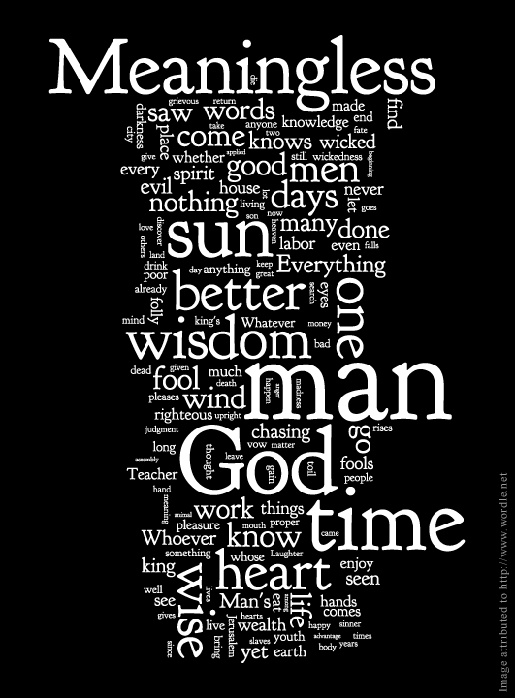
Meaning of Vanity:
Meaninglessness
Vanity of vanities, says the Preacher, vanity of vanities! All is vanity. (1:2)
Vanity of vanities, says the Preacher; all is vanity. (12:8)

Slide 8
What Profit Is There?

Slide 9
What Happens To Each Generation? (vs. 4)
“What is more vain than vanity: that the earth, which was made for humans, stays – but humans themselves, the lords of the earth, suddenly dissolve into the dust” -- Jerome

Slide 10
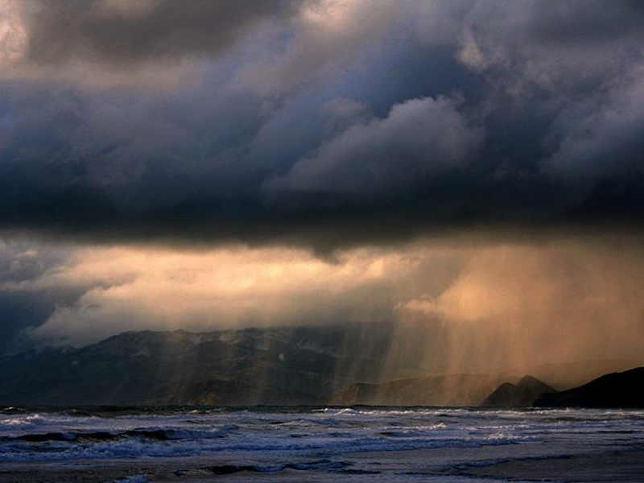
The Mundaneness Of Nature (vv. 5-8)
Sun goes east to west/Wind north to south
Water follows its course, then starts again
Repeated over and over and over and over and…
Vs. 8: The human experience is just as dull

Slide 11
The Past (vv. 9-11)
Will this ever change??
The only thing we learn from history is that we learn nothing from history
Who was your great great grandfather?
- What was his life’s dream?

Slide 12
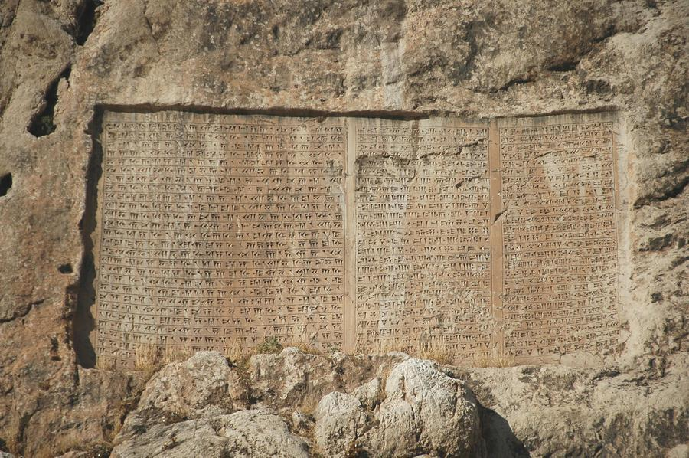
Royal Inscription (vv. 12-18)

Slide 13
Royal Inscription (vv. 12-18)
Self-Presentation: King over Israel in Jerusalem
Exploits: Seen everything under the sun
Boast: Acquired great wisdom
Comparison with Predecessors: Surpassed
Conclusions:
All is vanity and striving after the wind
Cannot change what God has done
Wisdom and knowledge bring vexation and sorrow

Slide 14
The Experiment Begins

Slide 15
The Experiment Begins
Pursuit of Pleasure (2:1-3)
Pursuit of Paradise (4-6)
Possessions (7-8a)
Sexual Pleasures (8b)
Hedonism (9-10)
Result (11)
“Pleasure’s advertising agency is better than its manufacturing department” – Derek Kidner

Slide 16
Wisdom is Good, but… (2:12-14)
No one can outdo “the king”
Gives positive view of wisdom

Slide 17
Wisdom is Good, but… (2:15-17)
Death is the “equalizer”
Death negates wisdom
Legacy will be forgotten
Note preacher’s view of death (17)
“If one fate comes to all, and that fate is extinction, it robs every man of his dignity and every project of its point” – Derek Kidner

Slide 18
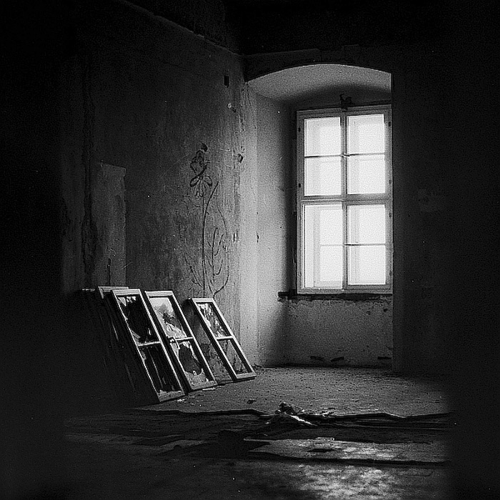
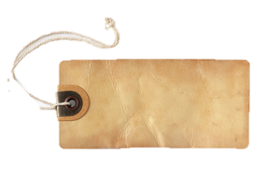
Wisdom is Good, but… (2:18-23)
No lasting legacy
Everything goes to someone else
No idea how hard earned money will be used
Shows limitation of wisdom (vs. 19)
Despair (vs. 21)
No legacy (vv. 22-23)
25¢ (obo)

Slide 19
First Preliminary Conclusion (2:24-26)
Enjoy what you have while you have it
“Toil that is tyrannical could have brought a joyful gift”
God is the one who decides
No escape from “hamster wheel”

Slide 20
Ecclesiastes
College View Church of Christ VBS
June, 2017
Class Two

Slide 21
The Poem of Life

Slide 22
The Poem of Life
Fourteen pairings – showing beginning/end
Main idea: Completion
Life is a “closed-circuit”

Slide 23
The Poem of Life
Reflections on the Poem: (vv. 9-11)
What is to be gained? (vs. 9)
Frustration
Eternity in the heart, but finite mind
“Bound by time, but wired for eternity” – Estes
Man has vainly sought to fill void “under the sun”

Slide 24
The Poem of Life
Conclusions (vv. 12-15)
Focus on the day-to-day outcomes
Still, this is a gift from God
Another picture of “recycled” history (vv. 14-15)

Slide 25
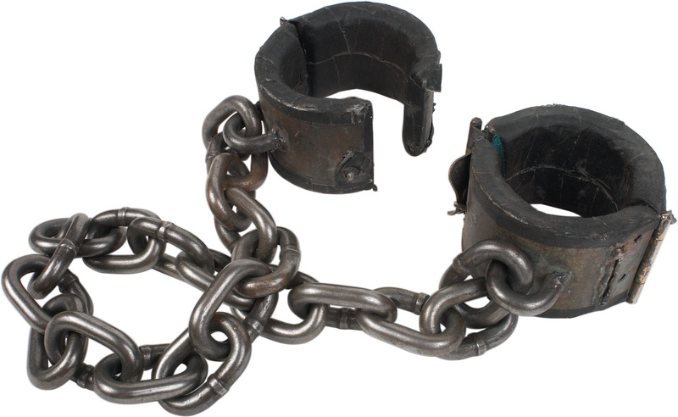
Reflections On Injustice (3:16-18)
Highest seat of justice occupied by injustice
God is ultimate judge…
Yet justice is not found under the sun
Justice can appear…beastly (vs. 18)

Slide 26
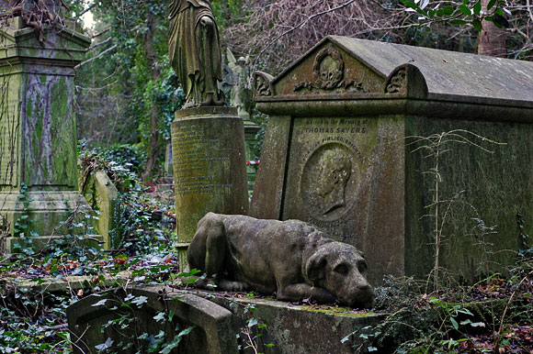
Reflections On Death (19-22)
And speaking of beasts…
Man and beast have same kind of death
Appear to share same fate…oblivion
Thus, enjoy the present
Best that can be done under the circumstances

Slide 27
Oppression (4:1-3)

Slide 28
Oppression (4:1-3)
Oppression exists; nothing can be done
No hope or consolation for the oppressed
Writer abhors what he sees
Better to be dead (the anesthesia for sufferers)
Better yet to have never been born

Slide 29
Problems With Work (4-6)
Jealousy is sole motivation for some
Laziness is no better; leads to “self-cannibalization”
Middle ground: enjoy what is gained in peace

Slide 30
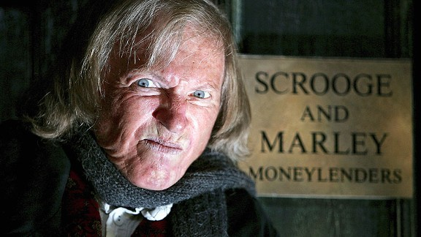
Rich and Lonely (7-8)
“Meaningless theme” continues
Man consumed by wealth
No one with whom to share it
No heir to enjoy it
Labor is vanity

Slide 31
Companionship (9-12)
Contrasts with the lonely miser
Is the writer a lonely old man?
Companionship provides…
Protection
Safety
Security

Slide 32
Nothing is Permanent (13-16)

Slide 33
Nothing is Permanent (13-16)
An old king won’t take advice
Replaced by a poor youth
Poor youth replaced by another
His “supporters” now support someone else

